Slide 1
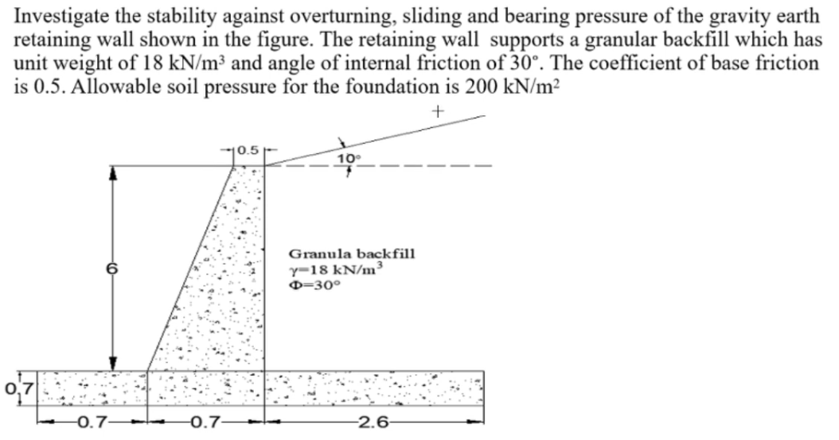
1. UR-CST management would like to construct a reinforced concrete wall to retain the soil around Muhabura block. You are tasked to investigate the soil, determine the properties of soil and design an appropriate reinforced retaining wall. No group supposed to have the same retaining wall dimensions.
2.

